Slide 1
Minimally Invasive and Endoscopic Management of Benign Prostatic Hyperplasia

Slide 2
Prostatic Urethral Lift
The prostatic urethral lift (PUL),
marketed under the name UroLift
developed in 2004 as a treatment option for BPH that works by altering prostatic anatomy without ablating tissue.
These permanent transprostatic implants take the form of sutures that are delivered by a handheld device through a cystoscope to mechanically open the prostatic urethra by compressing the prostate parenchyma.

Slide 3
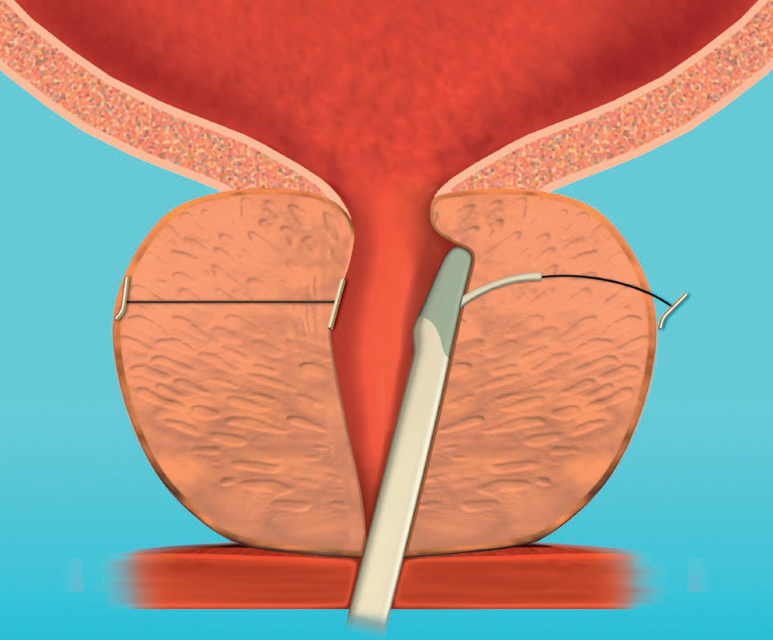
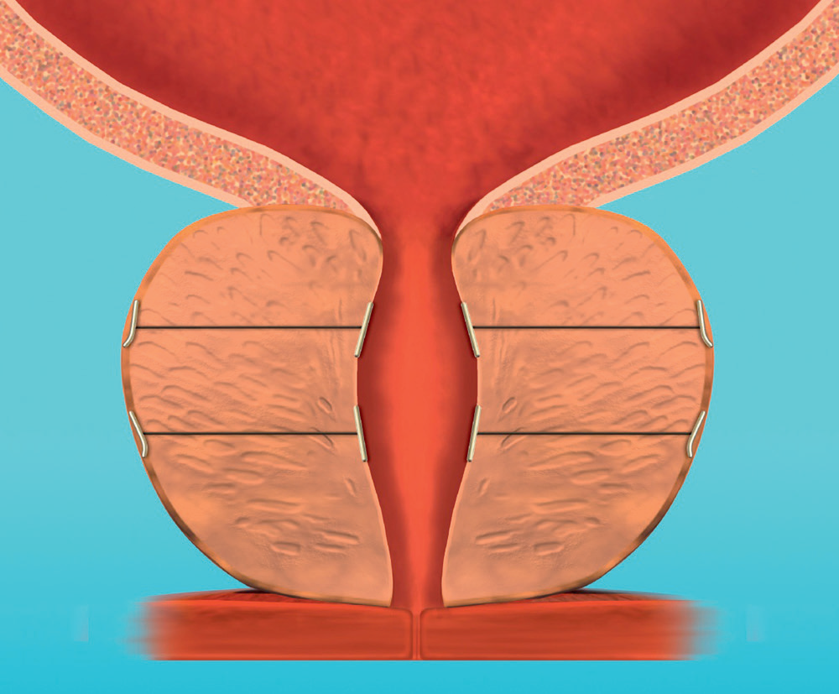

Slide 4
The PUL is used to treat the lateral lobes of the prostate and is thus not appropriate for patients with a median lobe.
The particular advantages of this technology include low rates of local symptoms along with minimization of impact on sexual factors like ED and ejaculatory problems.
The procedure is done through a rigid cystoscope sheath and can generally be performed in the office setting with only local anesthesia. Overall, the procedure is well tolerated with minor and self-limited postoperative adverse events.

Slide 5
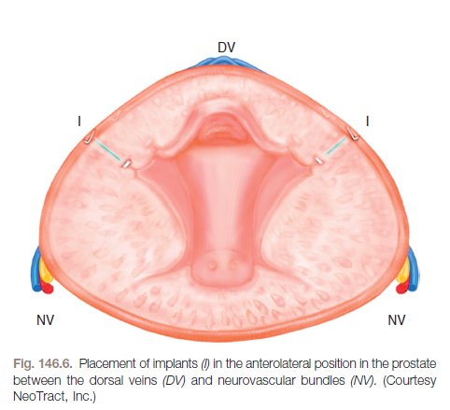

Slide 6
It is not suited for men with a gland larger than 80 g.
PUL is contraindicated in men with a median lobe, which is why providers should perform cystoscopy before evaluating urethral anatomy.

Slide 7
Convective Radiofrequency Water Vapor Thermal Therapy
Convective radiofrequency (RF) water vapor thermal therapy, marketed as Rezūm.
utilizes convective rather than conductive energy to ablate prostatic tissue.
Rezūm utilizes RF power to generate thermal therapy in the form of water vapor, which is injected transurethrally into the transition zone of the prostate.
The water vapor is injected at 103°C for 9 seconds at a pressure slightly above interstitial pressure, facilitating the dispersion of water vapor through the cellular interstices via convective energy.

Slide 8
Convective Radiofrequency Water Vapor Thermal Therapy
As the water vapor comes into contact with prostatic tissue, it condenses from steam to a liquid, releasing 540 calories of energy per gram onto the exterior cell membrane of the tissue, which causes cell death and tissue necrosis in a spherical ablative lesion of 1.5 to 2.0 cm, which has been confirmed by MRI and pathologic studies.

Slide 9
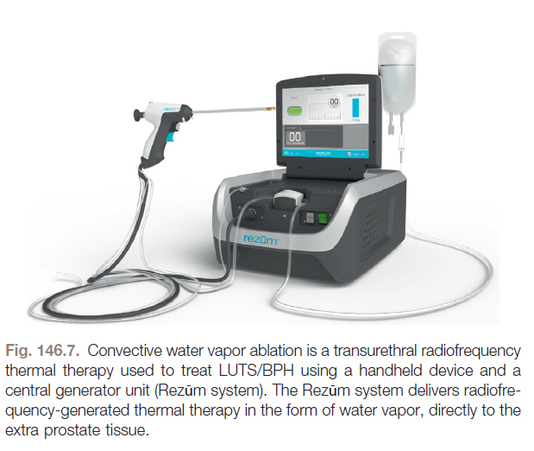

Slide 11
Convective Radiofrequency Water Vapor Thermal Therapy
Conclusion: Patients will benefit from improvement in clinical symptoms as measured by IIEF, Qmax, and QoL scores, including patients with a median lobe.
used cautiously in patients with a gland greater than 80 g and in men who have urinary retention.
This metod a favorable safety profile and a low retreatment rate, and it can be used in the office or outpatient setting using minimal anesthesia, making it an attractive option for both providers and patients, particularly those concerned with preserving sexual function.

Slide 12
Transurethral Vaporization of the Prostate
Prostate vaporization was first reported by Kaplan and Te in 1995.
However, this technique used the same set of equipment as TURP at that time with the exchange of the resecting loop for an element with a larger surface area.

Slide 13
Transurethral Vaporization of the Prostate
The power distribution along the electrode provides the advantages of TUVP.
As the leading edge of the electrode makes first contact with the virgin tissue (low electrical resistance), a high volume of energy is delivered, and tissue vaporization occurs.
The lagging edge of the electrode interacts with tissue that has already been desiccated to some degree giving it a higher resistance to the supplied energy.

Slide 14
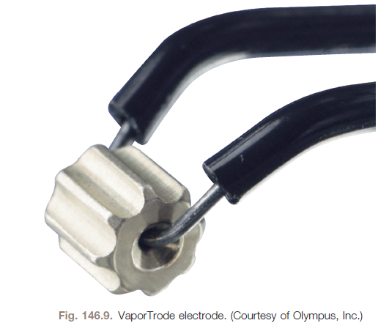
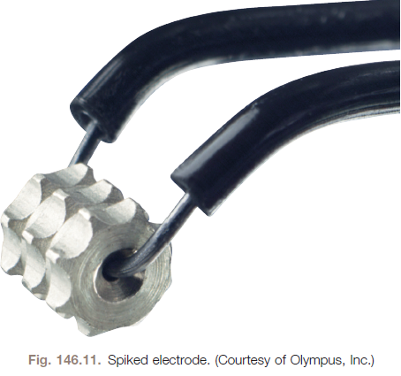
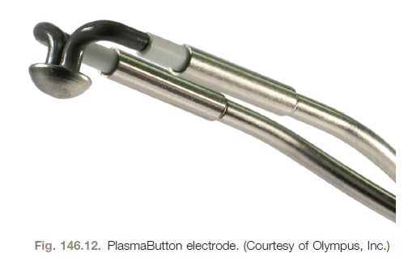

Slide 15
Transurethral Vaporization of the Prostate
Prostate electrovaporization continues to be a viable option for treatment of LUTS/BPH.
Although initially a very popular option for treatment of LUTS/BPH, widespread acceptance was likely tempered by questions about durability with a concern about dysuria and retreatment rates when used by itself.
The excellent hemostasis of the procedure leads to excellent intraoperative visualization and is currently most commonly used as an adjunct to TURP for improved hemostasis after resection is complete.
Although a significant innovation in its time, it appears that LASER vaporization is likely to supplant this as the preferred form of prostate vaporization for most providers.

Slide 16
Transurethral Microwave Therapy(TMT)
The objective of TUMT is to locally thermoablate prostate tissue while maintaining normal temperatures in the surrounding, nontargeted tissue.
This concept uses a specialized urethral catheter with an antenna that generates radially emitted electromagnetic (EM) waves.
These EM waves are in the frequency of 915 to 1296 MHz and penetrate tissue to induce changes that produce localized heat.

Slide 17
The potential advantages of microwave technology include the convenience of an in-office procedure with rapid patient convalescence and minimal anesthesia requirements. It is likely the least operator dependent of the treatments for BPH with an easy learning curve.
Mechanism of Action. The mechanism by which TUMT causes the reduction in LUTS/BPH is not completely understood. Multiple theories exist and are not mutually exclusive. These theories focus on altering prostate innervation or morphologic tissue changes in the prostate.

Slide 18
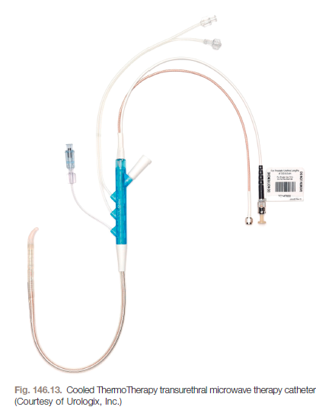
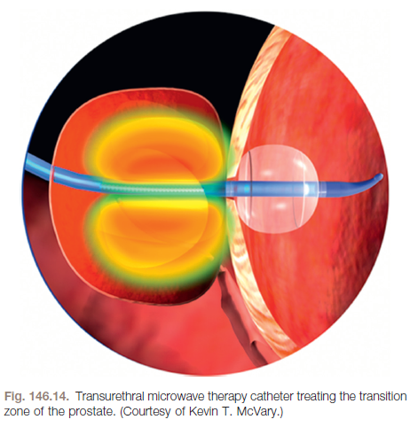

Slide 19
TUMT is a technology that is used to apply heat to the prostate, and its mechanism of action is still in debate decades later.
Although it does have a favorable overall complication profile compared with TURP, the risk for eventually requiring retreatment needs to be weighed carefully when considering TUMT for a patient.
The benefit of a MIST selection is the ability to perform the procedure in the office generally under just local anesthesia. As always, the patient’s ability to tolerate the procedure should be considered. Overnight admission is not needed, and patients are generally sent home directly after recovering from the procedure.

Slide 20
Transurethral Needle Ablation of the Prostate
The TUNA system is composed of an RF generator, a disposable urethral endoscopic catheter that attaches to a reusable catheter handle, and an optics system. The treatment concept and design was originally FDA approved in 1996 and was significantly updated in 2003.
The procedure was first performed in 1993.

Slide 21
Transurethral Needle Ablation of the Prostate
The specialized urethral endoscopic catheter is used for this procedure and is attached to a reusable control handle.
This rigid catheter is placed into the urethra and advanced into the prostate under direct vision as this device utilizes an embedded lens that is at either zero or 15 degrees based on surgeon preference.
Once in position, needles are deployed from the end of the catheter into the prostatic parenchyma.
The needles deploy at an acute angle to each other and at a right angle to the longitudinal axis of the catheter.
The needles have a variable length that can be adjusted to different prostate widths and sizes.
The urethra is protected from heat energy because of PTFE/nylon sheaths that extend to cover the proximal portions of the treatment needles.

Slide 22
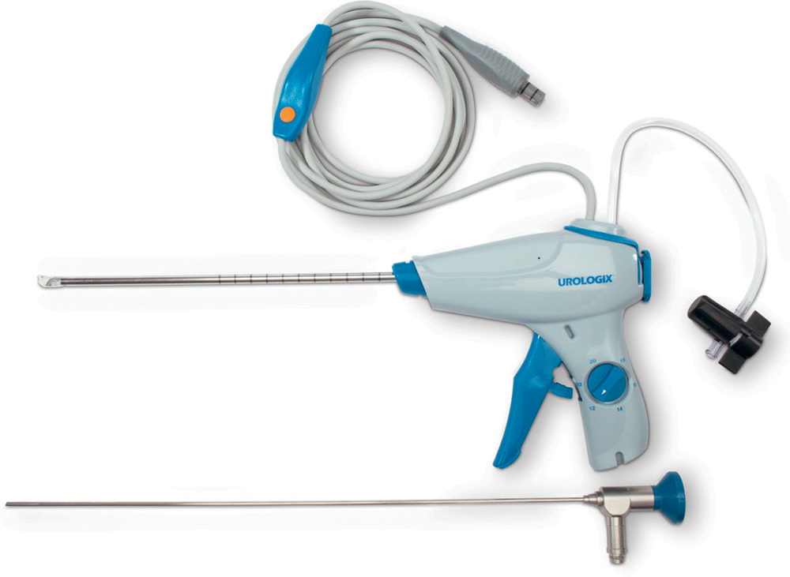
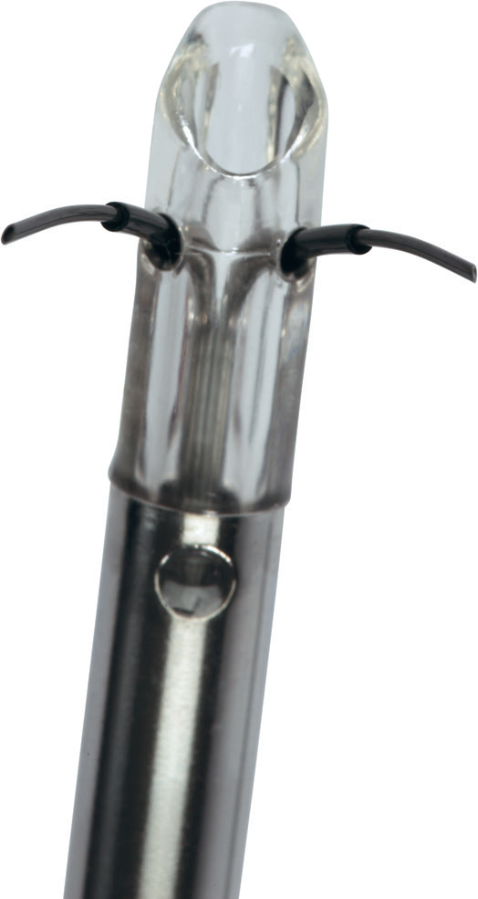

Slide 23
TUNA is indicated in men with bothersome LUTS who are refractory to medications with prostate sizes up to 80 g. Sterile urine should be verified before the procedure.
TUNA is not recommended in patients with metallic pelvic prostheses.
Additionally, a defibrillator or a pacemaker may receive EM interference from the procedure, and they should be considered a contraindication.
A benefit of TUNA is that the procedure can be done under local anesthesia. This can be done safely in the office setting without postoperative admission, although a 23-hour admission is not uncommon after the procedure.
The procedures should be done with a minimum of viscous urethral lidocaine, but oral or intravenous sedation may also be of benefit to the anxious patient.

Slide 24
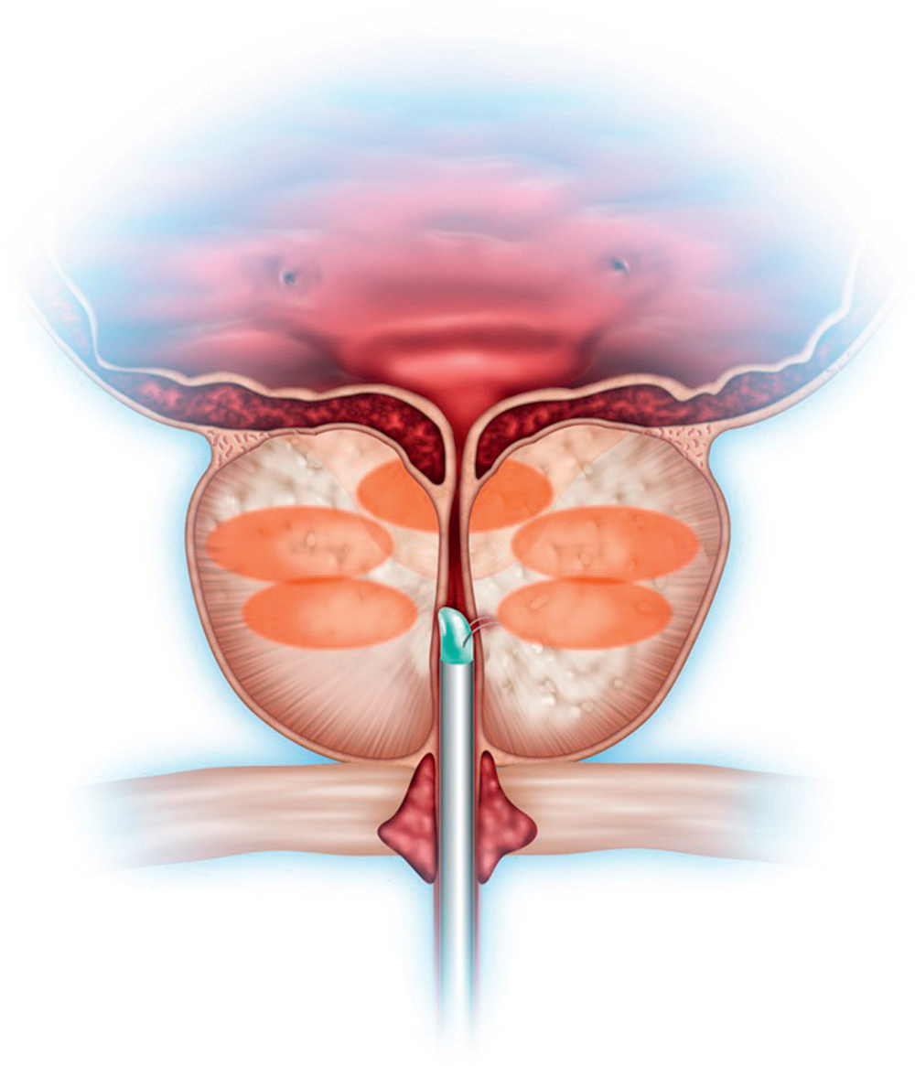

Slide 25
Transurethral Incision of the Prostate
dynamic role of peripheral condensation of the prostatic stroma acting as a capsule leading to BPH/LUTS has been proposed.
The alleviation of symptoms seen in patients with BPH treated with α-blockade also supports this capsular contraction or prostatic hypertonicity leading to symptoms.
Clearly, capsular constriction could further exacerbate the symptoms derived from an already hyperplastic prostate.

Slide 26
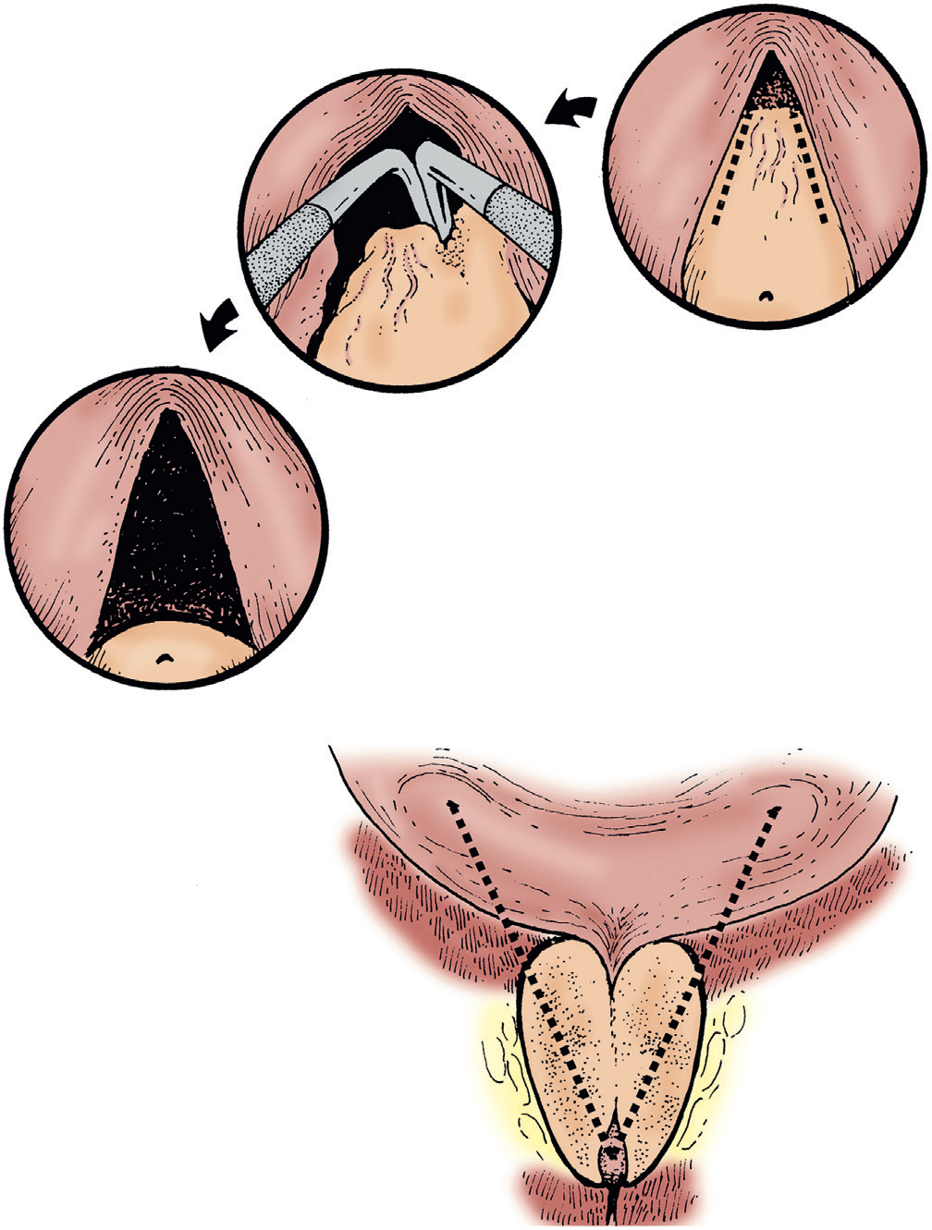

Slide 27
Transurethral Incision of the Prostate
TUIP offers reasonable results in correctly selected patients.
It does appear to have a lower risk for retrograde ejaculation compared with other treatment options, particularly TURP.
The operation is of short duration, and a minimal hospital stay is required.
This treatment should be discouraged in a patient with a larger prostate gland but may be of benefit in patients who are particularly concerned about retrograde ejaculation.

